Slide 1
Rayat Shikshan Saanstha’s Arts, Science & Commerce College, Mokhada Dist. : Palghar
Class : T.Y.B.Sc. Semester : V
Prepared by :- Mr. Patil Prashant K.

Slide 2
Transcendental & Polynomial Equations

Slide 3
Content
Mathematical Preliminaries
Concept of simple and multiple roots
Iterative methods
Iteration methods based on first degree equation:
Newton-Raphson method
Secant method
Regula-Falsi method
Iteration Method

Slide 4
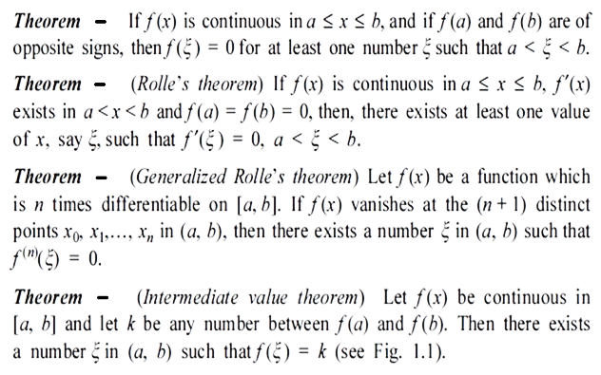
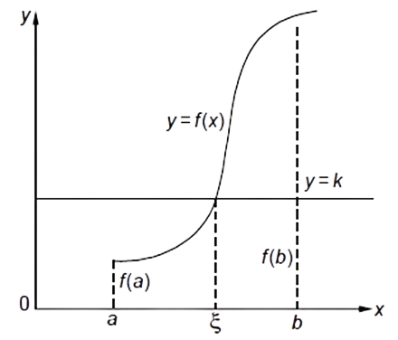
Mathematical Preliminaries

Slide 5
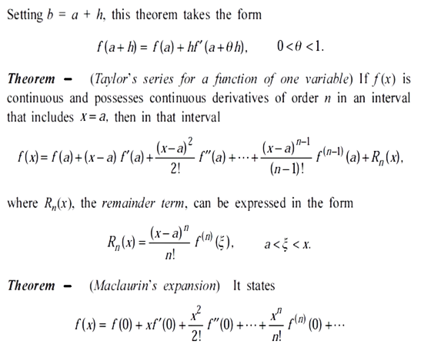

Slide 6
Concept of Simple and Multiple Root
Introduction
A problem that always has an importance in almost every branch of science, applied mathematics and engineering is to determine the roots/zeros of an equation of the form
f(x) = 0
A polynomial equation of the form
f(x) = P_{n}(x) = a_{n}x^{n} + a_{n-1}x^{n-1} + ··· + a₁x + a₀ = 0 …….(*)
Is called an Algebraic equation.
An equation which contains polynomials, exponential functions, logarithmic functions, trigonometric functions etc. is called a transcendental equation.

Slide 7
Examples
1) 3x³ – 2x² – x – 5 = 0,
x⁴ – 3x² + 1 = 0,
x² – 3x + 1 = 0,
are ,
2) xe^{2x} – 1 = 0,
cos x – xe^{x} = 0,
tan x = x
are .
algebraic (polynomial) equations
transcendental equations

Slide 8
Basic Terminology to locate roots
If f(x) is a polynomial of the form (*), then the following results from the theory of equations would be useful in locating roots
Every polynomial equation of the n^{th} degree has n and only n roots.
If n is odd, the polynomial equation has at least one real root whose sign is opposite to that of the last term. x – 1 = 0, x = 1 is root
If n is even and constant term is negative, then the equation has at least one positive & at least one negative root
If the polynomial equation has 1) real coefficients, then imaginary roots occur in pairs, and 2) rational coefficients, then irrational roots occur in pairs.
Descarte’s Rule of Signs:
A polynomial equation f(x) = 0 cannot have more no. of positive real roots than the no. of changes of sign in the coefficients of f(x).
In (a) above, f(x) = 0 cannot have more no. of negative real roots than the no. of changes of sign in the coefficients of f(-x).
f(x) = P_{n}(x) = a_{n}x^{n} + a_{n-1}x^{n-1} + ··· + a₁x + a₀ = 0 …….(*)

Slide 9
Definition of Root/Zero and its Geometrical representation
Root/zero A number α, for which f(α) ≡ 0 is called a root of the equation f(x) = 0, or a zero of f(x).
Geometrically, a root of an equation f(x) = 0 is the value of x at which the graph of the equation y = f(x) intersects the x-axis (as shown in figure)
f(x)
O
α
x

Slide 10
Simple Root
Simple root A number α is a simple root of f(x) = 0, if f(α) = 0 and
f ′(α) ≠ 0. Then, we can write f(x) as
f(x) = (x – α) g(x), g(α) ≠ 0.
For example, since (x – 1) is a factor of f(x) = x³ + x – 2 = 0, we can write
f(x) = (x – 1)(x² + x + 2) = (x – 1) g(x), g(1) ≠ 0.
Alternately, we find f(1) = 0, f ′(x) = 3x² + 1, f ′(1) = 4 ≠ 0.
Hence, x = 1 is a simple root of f(x) = x³ + x – 2 = 0.

Slide 11
Multiple Root
Multiple root A number α is a multiple root, of multiplicity m, of f(x) = 0, if
f(α) = 0, f ′(α) = 0, f ′’(α) = 0, ..., f ^{(m –1)} (α) = 0, and f ^{(m)} (α) ≠ 0.
Then, we can write f(x) as
f(x) = (x – α)^{m} g(x), g(α) ≠ 0.
For example, consider the equation f(x) = x³ – 3x² + 4 = 0.
We find f(2) = 8 – 12 + 4 = 0, f ′(x) = 3x² – 6x, f ′(2) = 12 – 12 = 0,
f ″(x) = 6x – 6, f ″(2) = 6 ≠ 0.
Hence, x = 2 is a multiple root of multiplicity 2 (double root) of
f(x) = x³ – 3x² + 4 = 0.
We can write f(x) = (x – 2)² (x + 1) = (x – 2)² g(x), g(2) = 3 ≠ 0.

Slide 12
Direct and Iterative Methods
The methods for finding the roots are classified as (i) direct methods, and (ii) iterative methods.
Direct methods: These methods give the exact values of all the roots in a finite number of steps. Therefore, for any direct method, we can give the total number of operations (additions, subtractions, divisions and multiplications). This number is called the operational count of the method.
There are direct methods for finding all the roots of cubic and fourth degree polynomials. However, these methods are difficult to implement & use.
Direct methods for finding the roots of polynomial equations of degree greater than 4 or transcendental equations are not available in literature.
Iterative methods: These methods are based on the idea of successive approximations. We start with one or two initial approximations to the root and obtain a sequence of approximations x₀, x₁, ..., x_{k}, ..., which in the limit as k → ∞, converge to the exact root α.
For example, the roots of the quadratic equation ax² + bx + c = 0, a ≠ 0, can be obtained using the method
x = $\frac{−b ± \sqrt{b^{2}−4ac}}{2a}$

Slide 13
Iteration methods based on first degree equation
We are going to study the following Numerical Methods to find Roots/Zeros of Algebraic & Transcendental equation.
Newton-Raphson method
Secant method
Regula-Falsi method
Iteration Method

Slide 14
Newton-Raphson Method
This method is also called Newton’s method. This method is also a Tangent method in which we approximate the curve near a root, by a straight line.
Let x₀ be an initial approximation to the root of f(x) = 0. Then, P(x₀, f₀), where f₀ = f(x₀), is a point on the curve. Draw the tangent to the curve at P (See Fig.). We approximate the curve in the neighbourhood of the root by the tangent to the curve at the point P. The point of intersection of the tangent with the x-axis is taken as the next approximation to the root. The process is repeated until the required accuracy is obtained.
y
P=P(x₀, f₀)
α
O
x₁
x₀
x

Slide 15
Continued..
The equation of the tangent to the curve y = f(x) at the point P(x₀, f₀) is given by
y – f(x₀) = (x – x₀) f ′(x₀)
where f ′(x₀) is the slope of the tangent to the curve at P. Setting y = 0 and solving for x, we get
x = $x_{0}−\frac{f\left(x_{0}\right)}{f^{′}\left(x_{0}\right)} ,$ f’(x₀) ≠ 0
The next approximation to the root is given by
x₁ = $x_{0}−\frac{f\left(x_{0}\right)}{f^{′}\left(x_{0}\right)} ,$ f’(x₀) ≠ 0
We repeat the procedure. The iteration method is defined as
x_{k+1} = $x_{k}−\frac{f\left(x_{k}\right)}{f^{′}\left(x_{k}\right)} ,$ f’(x_{k}) ≠ 0
This method is called the Newton-Raphson method or simply the Newton’s method.
The method is also called the Method of tangents.

Slide 16
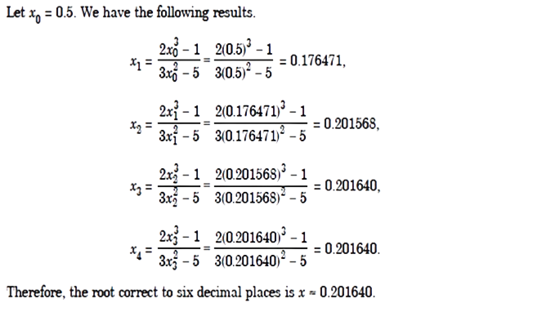

Slide 17
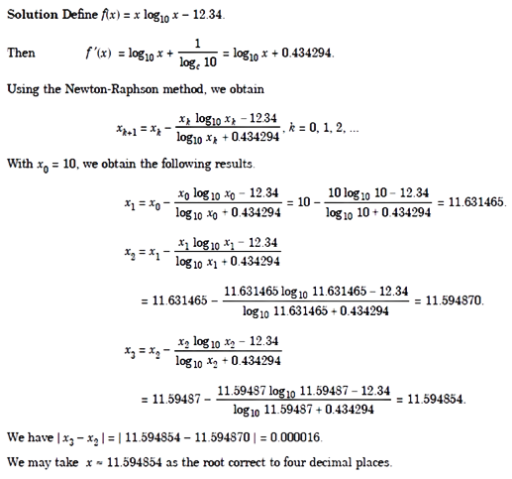

Slide 18
Convergence of Numerical Methods
We now study the rate at which the iteration methods converge to the exact root, if the initial approximation is sufficiently close to the desired root.
Define the error of approximation at the kth iterate as
ε_{k} = x_{k} – α, k = 0, 1, 2,...
Definition: An iterative method is said to be of order p or has the rate of convergence p, if p is the largest positive real number for which there exists a finite constant C ≠ 0 , such that
| ε_{k+1} | ≤ C | ε_{k} | ^{p}.
The constant C, which is independent of k, is called the asymptotic error constant and it depends on the derivatives of f(x) at x = α.
Let us now obtain the orders of the methods

Slide 19
Rate of Convergence of Newton-Raphson Method
The Newton-Raphson method is given by
x_{k+1} = $x_{k}−\frac{f\left(x_{k}\right)}{f^{′}\left(x_{k}\right)} ,$ f’(x_{k}) ≠ 0
Substituting x_{k} = ε_{k} + α, x_{k+1} = ε_{k+1} + α, we obtain
ε_{k+1} + α = ${\text{ε}\text{k} \text{+ }\text{α}}_{k}−\frac{f\left(∈_{k}+α\right)}{f^{′}\left(∈_{k}+α\right)}$
ε_{k+1} = ε_{k}$−\frac{f\left(∈_{k}+α\right)}{f^{′}\left(∈_{k}+α\right)}$
Expand the terms in Taylor’s series. Using the fact that f(α) = 0, we obtain
ε_{k+1} = ε_{k}$−$ $\frac{\left[{\text{ε}\text{k}f}^{′}\left(α\right)+\frac{1}{2}{ε_{k}^{2}f}^{′′}\left(α\right)+…\right]}{f^{′}\left(α\right)+\text{ε}\text{k}f′′(α)}$
Dividing by f’(α) we get
ε_{k+1} = ε_{k}$−$ $\left[{\text{ε}\text{k}}^{ }+\frac{1}{2}\frac{f^{′′}\left(α\right)}{f′(α)}ε_{k}^{2}+…\right]{\left[1+\frac{f′′(α)}{f′(α)}ε_{k}+…\right]}^{−1}$
∴
∴
∴
∴

Slide 20
Rate of Convergence : Continued
ε_{k+1} = ε_{k}$−$ $\left[{\text{ε}\text{k}}^{ }+\frac{1}{2}\frac{f^{′′}\left(α\right)}{f′(α)}ε_{k}^{2}+…\right]{\left[1−\frac{f′′(α)}{f′(α)}ε_{k}+…\right]}^{ }$
ε_{k+1} = ε_{k}$−$ $\left[{ }^{ } +…\right]$
ε_{k+1} = $\frac{1}{2}\frac{f^{′′}\left(α\right)}{f′(α)}ε_{k}^{2}$
Neglecting the terms containing $ε_{k}^{3}$ and higher powers of ε_{k}, we get
ε_{k+1} = C·$ε_{k}^{2}$ , where C = $\frac{1}{2}\frac{f^{′′}\left(α\right)}{f′(α)}$
And | ε_{k+1} |= C·| ${ε_{k} |}^{2}$
Therefore, Newton’s method is of order 2 or has quadratic rate of convergence.
∴
∴
$$\text{ε}\text{k}$$
- $\frac{1}{2}\frac{f^{′′}\left(α\right)}{f′(α)}ε_{k}^{2}$
$$\frac{1}{2}\frac{f^{′′}\left(α\right)}{f′(α)}ε_{k}^{2}$$
$$−\frac{f^{′′}\left(α\right)}{f′(α)}ε_{k}^{2}$$
∴
= $−\frac{1}{2}\frac{f^{′′}\left(α\right)}{f′(α)}ε_{k}^{2}$
∴

Slide 21
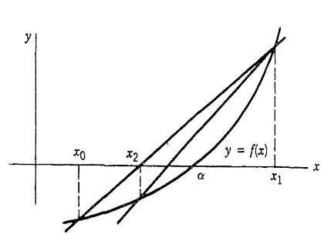
Secant method
As with Newton's method, the graph of y = f(x) is approximated by a straight line in the vicinity of the root α. In this case, assume that x₀ and x₁ are two initial estimates of the root α. Approximate the graph of y = f(x) by the secant line determined by (x₀ , f(x₀)) and (x₁, f(x₁)).
Let its root be denoted by x₂; we hope it will be an improved approximation of α. This is illustrated in Figure. Using the slope formula with the secant line, we have
$\frac{{f(x}_{1})− {f(x}_{0})}{x_{1}−{ x}_{0}}$ = $\frac{{f(x}_{1})− 0}{x_{1}−{ x}_{2}}$
Solving for x₂,
x₂ = x₁ – f(x₁)·$\frac{x_{1}− x_{0}}{{f(x}_{1}) − {f(x}_{0})}$

Slide 22
Secant method :- Continued
Using x₁ and x₂ , repeat this process to obtain x₃ , etc.
The general formula based on this is
x_{k+1} = x_{k} – f(x_{k})·$\frac{x_{k} − x_{k−1}}{{f(x}_{k}) −{ f(x}_{k−1})}$, k ≥ 1
x_{k+1} = $\frac{x_{k−1}{f(x}_{k}) − x_{k}{f(x}_{k−1})}{{f(x}_{k}) − {f(x}_{k−1})}$ , k ≥ 1
If we write f(x_{k}) = f_{k} then
x_{k+1} = $\frac{x_{k−1}f_{k} −{ x}_{k}f_{k−1}}{f_{k }− f_{k−1}}$ , k ≥ 1
This is the secant method.
∴
∴
∴

Slide 23
Examples
Find a real root of the equation x³ – 2x – 5 = 0 using Secant method
Ans : Let the two initial approximation be given by
x₀ = 2 and x₁ = 3
We have
f(x₀) = f₀ = -1 and f(x₁) = f₁ = 16
Putting k = 1 in the formula x_{k+1} = $\frac{x_{k−1}f_{k} −{ x}_{k}f_{k−1}}{f_{k }− f_{k−1}}$ …… (*) we get
x₂ = $\frac{x_{0}f_{1} −{ x}_{1}f_{0}}{f_{1 }− f_{0}}$
∴ x₂ = $\frac{\left(2\right)\left(16\right)−(3)(−1)}{16 −(−1)}$ = $\frac{35}{17}$ = 2.058823529
Also f(x₂) = f₂ = - 0.390799923
Putting k = 2 in the eq. (*) we get
x₃ = $\frac{x_{1}f_{2} −{ x}_{2}f_{1}}{f_{2 }− f_{1}}$ = $\frac{\left(3\right)\left(−0.390799923\right) −(2.058823529)}{−0.390799923 −16}$
∴ x₃ = 2.08126366
Again f(x₃) = f₃ = - 0.147204057
Now setting k =3 in (*) we get, x₄ = 2.094824145 which is correct upto three significant figure.
x₀
x₂
x₄
x₁
2
x₃
3

Slide 24
Example
Using Secant method, find the real root of the equation
f(x) = xe^{x} – 1= 0
Ans : We have f(0) = -1 = f₀ and f(1) = e – 1 = 1.71828 = f₁
Therefore, a root lies between 0 and 1.Let x₀ = 0 and x₁ = 1,
Putting k = 1 in the formula x_{k+1} = $\frac{x_{k−1}f_{k} −{ x}_{k}f_{k−1}}{f_{k }− f_{k−1}}$ …… (*) we get
Therefore, x₂ = $\frac{x_{0}f_{1} −{ x}_{1}f_{0}}{f_{1 }− f_{0}}$ = $\frac{1}{2.71828}$ = 0.36788
And f₂ = 0.36788·e^{0.36788} – 1 = - 0.46854
Now, x₃ = $\frac{x_{1}f_{2} −{ x}_{2}f_{1}}{f_{2 }− f_{1}}$ = $\frac{1\left(−0.46854\right)−(0.36788)(1.71828)}{−0.46854 − 1.71828}$ = 0.50332
and f₃ = - 0.16740
So, x₄ = $\frac{x_{2}f_{3} −{ x}_{3}f_{2}}{f_{3 }− f_{2}}$ = 0.57861
and f₄ = 0.03198
Hence, continuing in this process we get
x₅ = 0.56653 and f₅ = - 0.00169
x₆ = 0.56714 and f₆ = - 0.0001196
It follows that the required root is 0.5671, correct upto four decimal places.

Slide 25
Rate of Convergence of Secant Method
The formula of Secant method is given by
x_{k+1} = $\frac{x_{k−1}{f(x}_{k}) − x_{k}{f(x}_{k−1})}{{f(x}_{k}) − {f(x}_{k−1})}$ , k ≥ 1. This formula can also be written as
x_{k+1} = x_{k} – f(x_{k})·$\frac{x_{k} − x_{k−1}}{{f(x}_{k}) −{ f(x}_{k−1})}$, k ≥ 1 ………….(*)
Substituting x_{k} = ε_{k} + α, x_{k+1} = ε_{k+1} + α, in eq. (*) we obtain
ε_{k+1} + α = ε_{k} + α - $\frac{\left(ε_{k}+α\right)−(ε_{k−1}+α) }{{f(x}_{k}) − {f(x}_{k−1})}∙{f(x}_{k})$
ε_{k+1} = ε_{k} - $\frac{ε_{k}−ε_{k−1} }{{f(x}_{k}) − {f(x}_{k−1})}∙{f(x}_{k})$
ε_{k+1} = ε_{k} - $\frac{{f(x}_{k})\text{∙}ε_{k}−{f(x}_{k}){∙ε}_{k−1} }{{f(x}_{k}) − {f(x}_{k−1})}$
ε_{k+1} = $\frac{{f(x}_{k})\text{∙} ε_{k−1}−{ f(x}_{k−1})\text{∙}ε_{k}}{{f(x}_{k}) − {f(x}_{k−1})}$ ……………………..(A)
Now by Mean value theorem, ∃ a η_{k} ∈ [x_{k}, α] such that
f’(η_{k}) = $\frac{f\left(x_{k}\right)−f(α)}{x_{k} − α}$

Slide 26
Continued..
Now put f(α) = 0 and x_{k} – α = ℰ_{k} we get
f’(η_{k}) = $\frac{f\left(x_{k}\right) −0}{ε_{k}}$ = $\frac{f\left(x_{k}\right)}{ε_{k}}$
Thus, f(x_{k}) = ℰ_{k} f’(η_{k}) …………….(1)
Similarly, f(x_{k-1}) = ℰ_{k-1} f’(η_{k-1}) ……(2)
Using eq. (1) & (2) in eq. (A) we get
ε_{k+1} = $\frac{f′(η_{k})∙ε_{k}\text{∙ }ε_{k−1}− \text{f}\text{ ′(}η_{k−1})\text{∙ }ε_{k−1}\text{∙}ε_{k}}{{f(x}_{k}) − {f(x}_{k−1})}$
ε_{k+1} = ${(ε}_{k}\text{∙ }ε_{k−1}$) $\frac{f^{′}\left(η_{k}\right)− \text{f}\text{ ′(}η_{k−1})}{{f(x}_{k}) − {f(x}_{k−1})}$
i.e. ε_{k+1} = C${ ∙(ε}_{k}\text{∙ }ε_{k−1}$) where, C = $\frac{f^{′}\left(η_{k}\right)− \text{f}\text{ ′(}η_{k−1})}{{f(x}_{k}) − {f(x}_{k−1})}$ …......(3)
By definition of rate of convergence,
the method is of order p if | ε_{k+1} | ≤ C | ε_{k} | ^{p}
i.e. | ε_{k} | ≤ C | ε_{k-1} | ^{p}
So, using (3) & (4) we get $ε_{k}^{p}$= C${ ∙(ε}_{k−1}\text{∙ }ε_{k−1}$)
ε_{k} = C$(ε_{k−1}$)^{(p+1)/p} ………....(5)
Now by comparing equation (4) & (5) we get
p = (p +1) / p
(4)

Slide 27
Continued
p² – p – 1 = 0
p = $\frac{1 ± \sqrt{5}}{2}$
Here p > 0, so p = $\frac{1+ \sqrt{5}}{2}$ = 1.618
Thus, | ε_{k+1} | ≤ C | ε_{k} | ^{1.618}
Hence, the rate of convergence of Secant method is $\frac{1 ± \sqrt{5}}{2}$ = 1.618

Slide 28
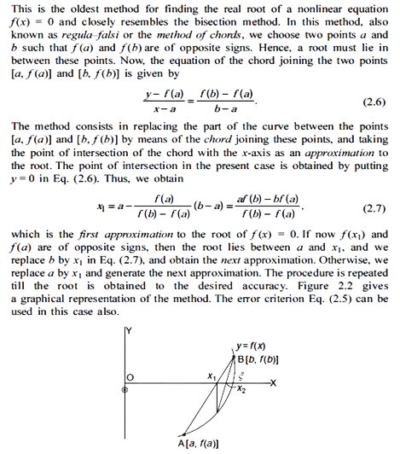
False Position Method

Slide 29
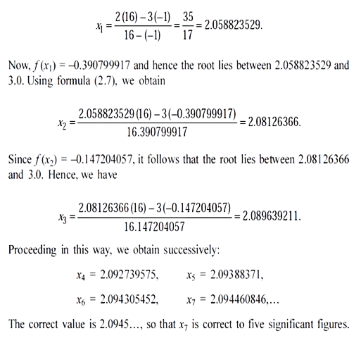
Example

Slide 30
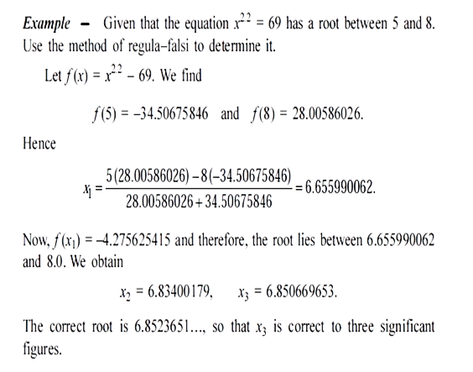
Example

Slide 31
Iteration Method
An iterative method for finding a root of the equation f(x) = 0 can be rewritten as x = φ(x)
This method uses one initial approximation to the root x₀. The sequence of approximations is given by
x₁ = φ(x₀),
x₂ = φ(x₁), x₃ = φ(x₂), ..... And so on ..
Hence, x_{k + 1} = φ(x_{k}), k = 0, 1, 2, .....
The function φ is called an iteration function and x₀ is called an initial approximation.
If a method uses two initial approximations x₀, x₁, to the root, then we can write the method as
x_{k + 1} = φ(x_{k – 1}, x_{k}), k = 1, 2, .....

Slide 32
References
Introductory methods of numerical analysis by S.S. Sastry
Kendall E. & Atkinson, An Introduction to Numerical Analysis-Wiley
M. K. Jain, S. R. K. Iyengar and R. K. Jain, Numerical Methods for Scientific and Engineering Computation, New Age International Publications.

